Slide 1
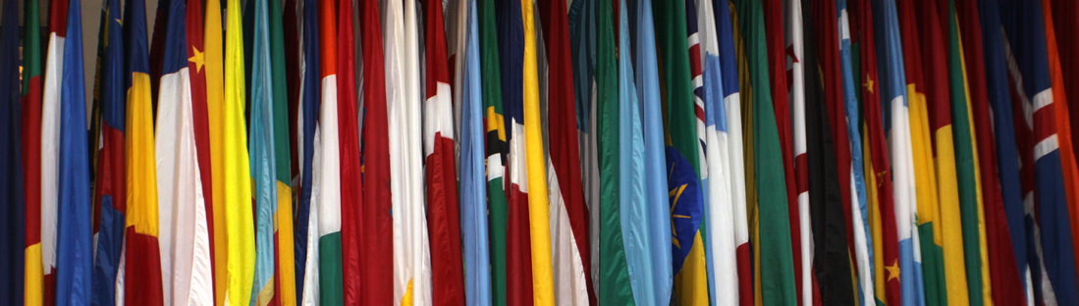
The International Monetary Fund in a changing world
Anthony De Lannoy, Executive Director
Sofia, Bulgaria
April 27, 2018

Slide 2
Introduction
IMF governance
The Dutch-Belgian Constituency
European representation
Tasks
IMF-supported programs in Greece
The IMF in Bulgaria
The IMF in a changing world
Challenges for the future

Slide 3
I. Introduction
Origins: established in Bretton Woods, New Hampshire, in 1944
Members: from 44 member states in 1945 to 189 member states in 2018; only the UN has more member states (193):
  Andorra, Cuba, Liechtenstein, Monaco, and North Korea are not a member of the IMF
  Kosovo is a member of the IMF, but not of the UN
IMF | World Bank
International monetary cooperation | LT economic development and poverty reduction
Provides loans and helps countries design policy programs to solve balance of payments problems | Projects, sector reforms (health, education…)
ST/MT loans funded through quota contributions/bilateral loans | LT loans funded through member country contributions/bond issuance

Slide 4
II. IMF governance - quota
Quota: a country’s quota is based on the country’s relative position in the world economy, calculated as a weighted average of GDP (50%), openness (30%), economic variability (15%), and international reserves (5%). GDP is measured through a blend of GDP, based on market exchange rates (60%) and on PPP exchange rates (40%). The formula also includes a compression factor which somewhat improves the position of small(er) countries
A country’s quota determines its:
Capital contribution: the maximum amount of financial resources the member is obliged to provide to the IMF (25% reserve currency, 75% own currency)
Voting power: the relative power of the member within the institution
Access to financing: a distinction is made between normal access and exceptional access

Slide 5
II. IMF governance - overview
Board of Governors
One Governor from each member state
Annual Meetings
IMFC
International Monetary and Financial Committee
24 Governors
Spring and Annual Meetings
advises
Executive Board
24 Executive Directors
Conducts day-to-day business
Meets several times a week
Management
&
Staff
+/-2700
Crucial aspect of the IMF’s governance:
nearly all decisions are taken by consensus
(legally: simple or special 70%/85% majority)

Slide 6


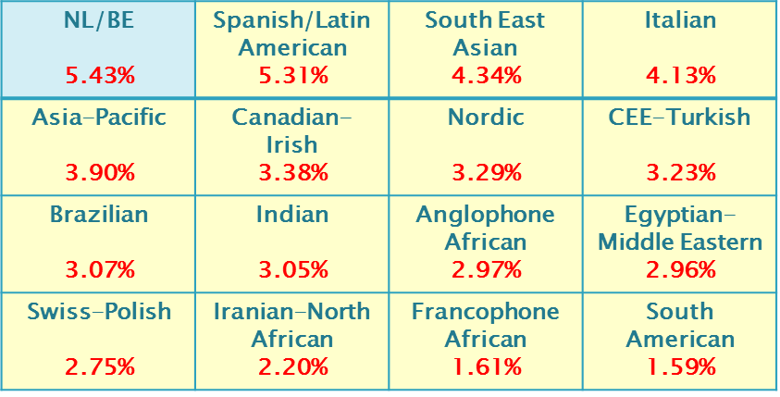




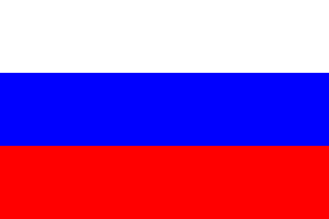

II. IMF governance – Executive Board
24 Executive Directors
8 single country Chairs
16 Constituencies
USA
16.53%
Japan
6.16%
China
6.09%
Germany
5.32%
UK
4.04%
France
4.04%
Russia
2.59%
Saudi Arabia
2.02%

Slide 7



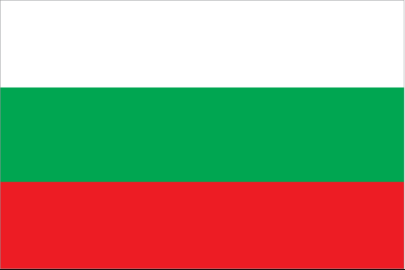
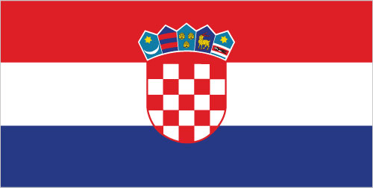
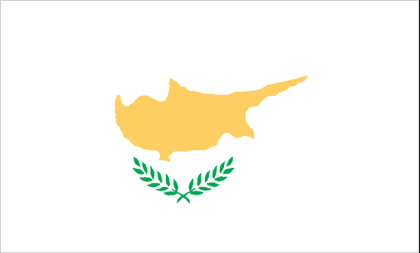


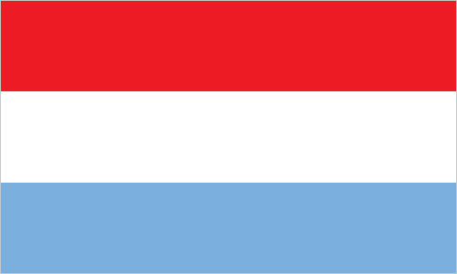
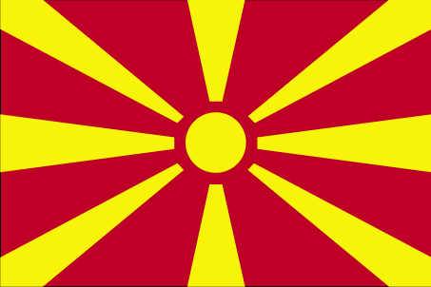

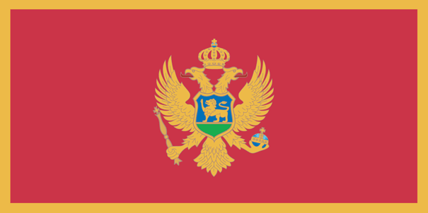
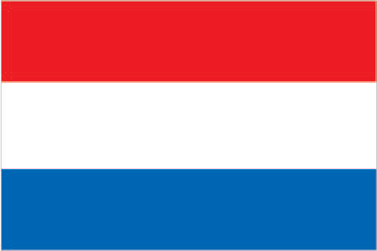


III. The Dutch-Belgian Constituency
0.05% 1.30% 0.08% 0.21% 0.17%
0.09% 0.07% 0.41% 0.29% 0.06%
0.06% 0.04% 1.77% 0.39% 0.43%

Slide 8
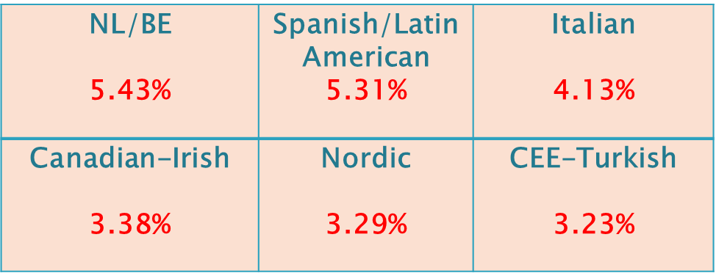
IV. European representation
Freedom of choice: IMF members freely choose a constituency:
28 EU member states are spread across 9 chairs
18 Euro Area member states are spread across 8 chairs
Representation: nor the EU, nor the Euro Area are members of the IMF. The ECB has an observer on the Executive Board and the IMFC. The European Commission only has observer status at the IMFC
Single EA chair: the European Commission’s long term aim is a single Euro Area chair in the IMF, and thus to have a more unified and coherent external representation of the Euro Area

Slide 9
V. Tasks – three pillars
Surveillance
Capacity development
Lending

Slide 10
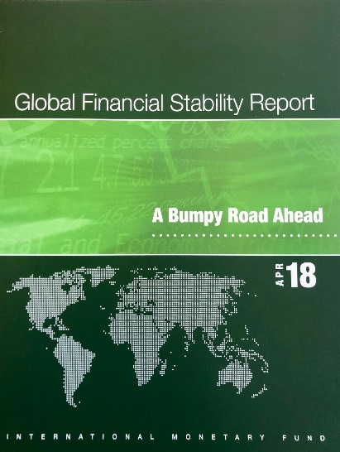
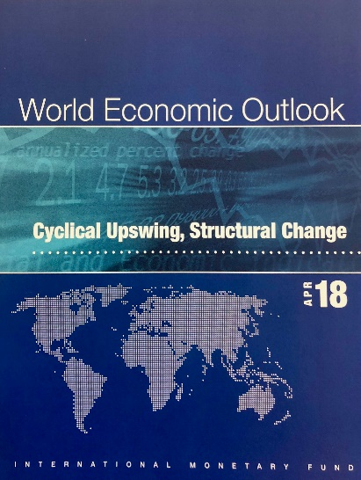
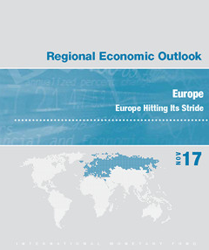
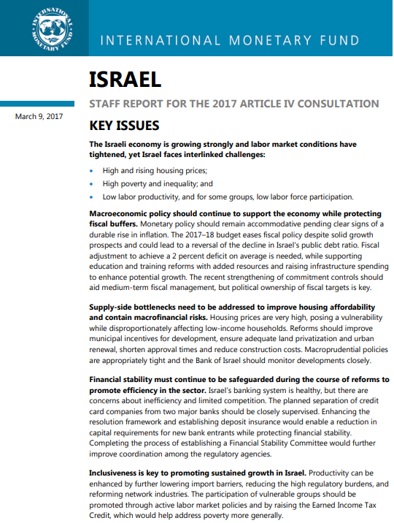
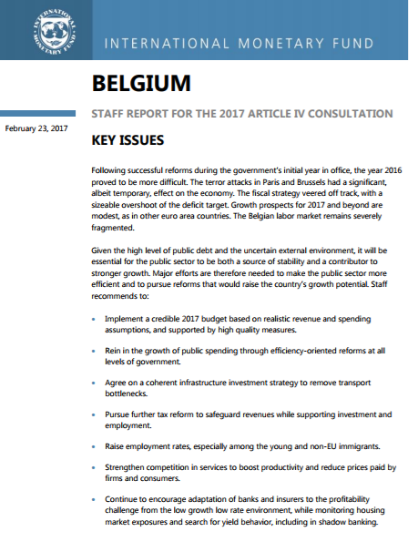
V. Tasks - surveillance
Surveillance: covers macroeconomic policies, financial sector stability, risks and vulnerabilities, as well as institutional and structural issues
Global Regional Bilateral

Slide 11
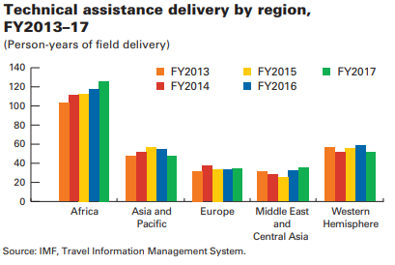
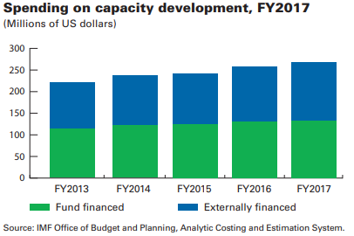
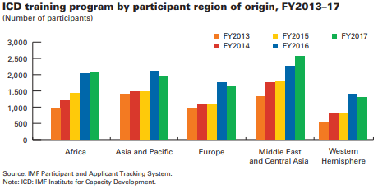
V. Tasks – capacity development
Capacity development: consists of technical assistance and training

Slide 12
V. Tasks - lending
International payments: the IMF provides loans to countries that have trouble meeting their international payments and cannot otherwise find sufficient financing on affordable terms
Balance of Payments problem: international payments require reserve currency (USD, EUR, JPY, GBP…). Countries run out of reserves e.g. because of a sharp drop in export receipts (e.g. fall in commodity prices), speculative attacks against a fixed exchange rate, loss of access to capital markets because of high debt levels…
Stabilization: IMF financial assistance is designed to help countries restore macroeconomic stability by rebuilding their international reserves, stabilizing their currencies, and staying current on international payments

Slide 13
V. Tasks - lending
Conditionality: conditions linked to an IMF loan are focused and country-specific in order to address the underlying causes of the crisis that forced the member to request an IMF loan
Disbursement of resources: once an IMF-supported program is approved, the loan is released in phased installments as the program is effectively carried out
Precautionary credit lines: to members with strong fundamentals and a strong track record of policy implementation (e.g. Flexible Credit Line, Precautionary and Liquidity Line)
Non-financial: the IMF can help countries design an economic program that delivers clear signals to donors and/or the markets on the basis of the IMF’s endorsement of the strength of the country’s policies

Slide 14
V. Tasks - lending
Concessional financing: low-income countries can obtain concessional financing under the Poverty Reduction and Growth Trust (PRGT), which allows them to lend at substantially reduced interest rates. To help low-income countries cope with the global financial crisis, zero interest are currently charged on all concessional lending
Debt relief: the IMF has provided substantial debt relief to low-income countries under the Heavily Indebted Poor Countries (HIPC) Initiative and the Multilateral Debt Relief Initiative (MDRI); to date, 36 countries, of which 30 in Africa, have benefited from US$76 billion in debt-service relief over time

Slide 15
V. Tasks - lending
Reaccumulation of debt in low-income countries: however, many low-income countries have reaccumulated debt post debt relief, often linked to the emergence of non-traditional creditors (e.g. China)

Slide 16
V. Tasks - lending
Non-concessional | Concessional
Stand-By Arrangement (SBA) Present/potential BoP needs Up to 3 years, typically 12-18 months | Standby Credit Facility (SCF) 1-2 years
Extended Fund Facility (EFF) Protracted/medium-term BoP needs Up to 4 years | Extended Credit Facility (ECF) 3-4 years, extendable to 5 years
Flexible Credit Line (FCL) Precautionary, very strong fundamentals/policies 1 or 2 years
Precautionary and Liquidity Line (PLL) Precautionary, sound fundamentals/policies 6 months, 1 or 2 years
Rapid Financing Instrument (RFI) Emergency assistance, outright disbursement limited access, no ex-post conditionality | Rapid Credit Facility (RCF)
Policy Coordination Instrument (PCI) Non-financial, for signaling purposes 6 months to 4 years | Policy Support Instrument (PSI) 3-4 years, extendable to 5 years

Slide 17
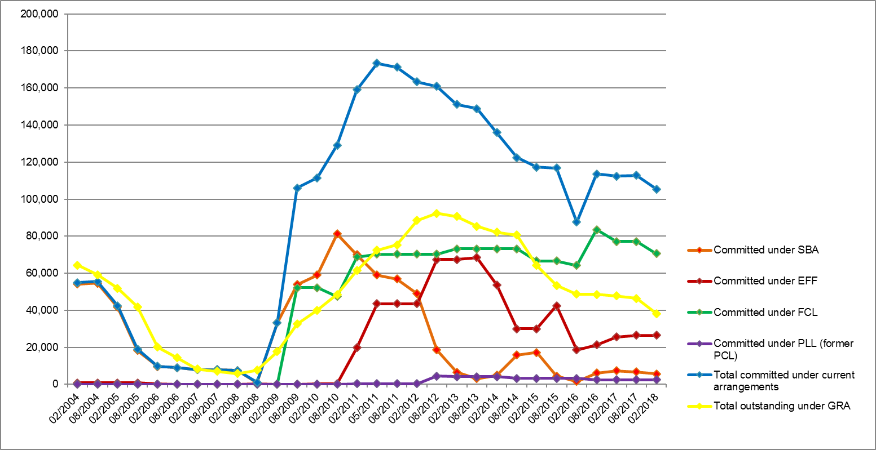
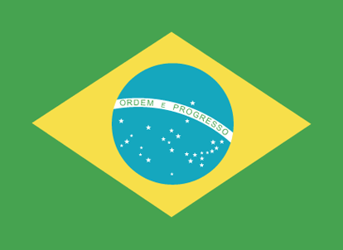
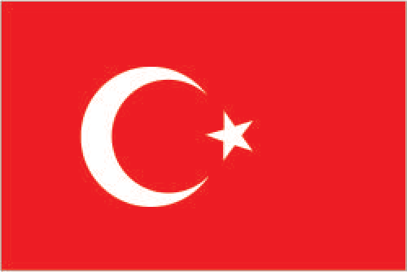

V. Tasks - lending
Lending during the global financial crisis: spectacular increase in lending compared to the period <2009
173 336 mSDR
FCC 246 200 mSDR
105,337 mSDR
FCC 220,900 mSDR

Slide 18
V. Tasks - lending
Largest borrowers: the regional composition of the members with the largest non-concessional programs changed substantially during the global financial crisis
02/2008 | 05/2011 | 02/2018
Turkey 6 662 mSDR | Greece 26 432 mSDR | Ukraine 12 348 mSDR
Iraq 475 mSDR | Portugal 23 742 mSDR | Egypt 8 597 mSDR
Peru 172 mSDR | Ireland 19 466 mSDR | Iraq 3 831 mSDR
Gabon 77 mSDR | Ukraine 10 000 mSDR | Tunisia 2 046 mSDR
FYR Macedonia 52 mSDR | Pakistan 7 236 mSDR | Jamaica 1 195 mSDR

Slide 19
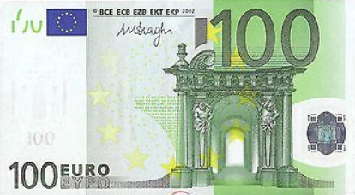
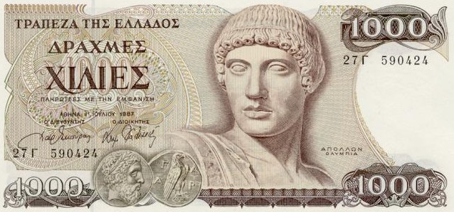
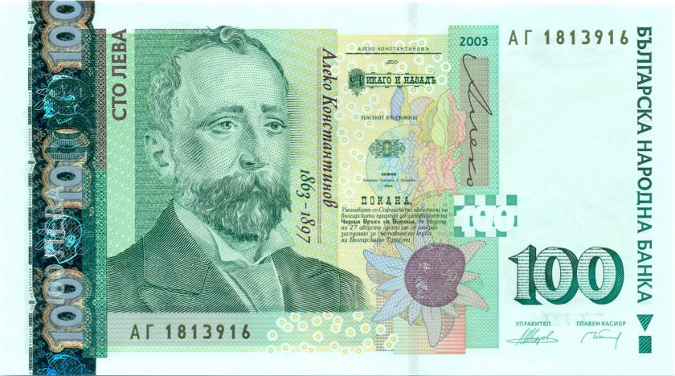
V. Tasks - lending
Balance of Payments deficit: the Balance of Payments is always balanced. When more reserve currency leave the country than enter, the international reserves of the central bank decline. This may lead to a crisis and a sharp devaluation of the currency
Euro Area: why did a member of the Euro Area suffer a Balance of Payments problem, despite the euro being a reserve currency?
Bulgaria: did Bulgaria ever suffer a Balance of Payments problem? Did Bulgaria enter into an IMF-supported program?

Slide 20
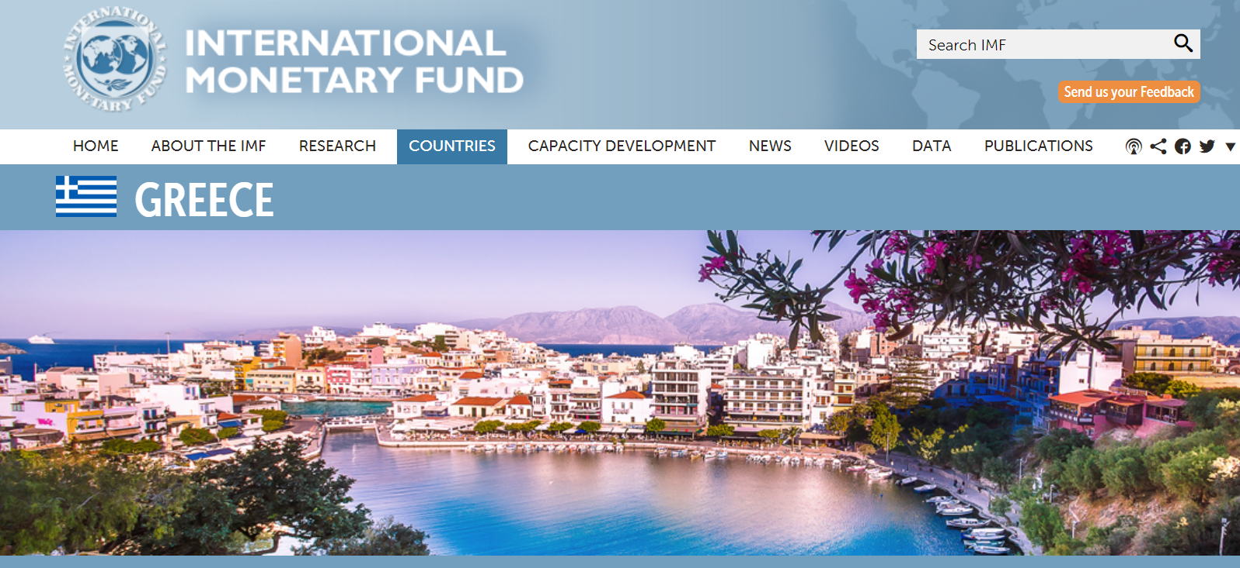
VI. IMF-supported programs in Greece

Slide 21
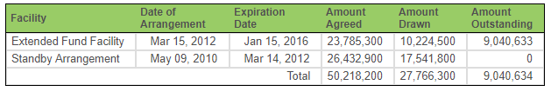
VI. IMF-supported programs in Greece
Lending: Greece entered into two IMF arrangements since the start of the global financial crisis
Greece: IMF-supported programs (SDR thousand)
European support: these two IMF arrangements were part of three economic programs/financial assistance packages, with the bulk of financial assistance coming from EU member states/institutions
Third IMF arrangement: in July 2017, the IMF, in principle, approved a EUR 1.6 billion precautionary SBA. It will become effective only after the IMF receives assurances from EU member states/institutions on debt sustainability, and under the condition that the third economic program remains on track

Slide 22
VI. IMF-supported programs in Greece
May 2010 | First European Economic Adjustment Program (EAP) worth up to EUR 80 billion First IMF arrangement (SBA 05/2010-03/2012) worth up to EUR 30 billion
March 2012 | Second EAP, including private sector involvement (53.5 % write-down for investors in Greek bonds), worth up to EUR 130 billion Second IMF arrangement (EFF 03/2012-01/2016) worth up to EUR 28 billion
June 2013 | IMF admits that the handling of the Greek debt crisis has not yielded the expected results
January 2015 | Political crisis in Greece lead to early elections in which Syriza comes to power
January-June 2015 | Difficult negotiations on progress under the second EAP; fears of a Greek default rise Greece temporarily fails to repay EUR 1.5 billion to the IMF
August 2015 | Third EAP worth up to EUR 86 billion
February 2017 | Tensions between the IMF and EU member states/institutions over Greece’s debt sustainability IMF warns that Greece’s debt is unsustainable and debt relief is necessary, and that too high budget cuts will hamper Greece’s ability to grow EU member states/institutions agree to more lenient budget targets, but decline to consider debt relief at this stage
July 2017 | IMF approves, in principle, a EUR 1.6 billion precautionary SBA, conditional on assurances from EU member states/institutions on debt sustainability, and under the condition that the third economic program remains on track

Slide 23
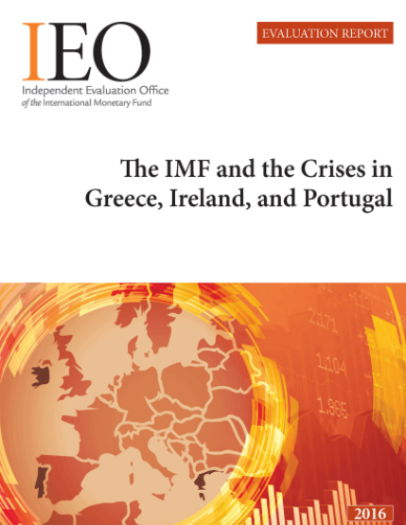
VI. IMF-supported programs in Greece
Evaluation of IMF engagement: in 2016 the Independent Evaluation Office examined the effectiveness of the IMF’s engagement in Greece, Ireland, and Portugal in 2010–2014 in order to draw lessons and to enhance transparency
Recommendations: the IEO acknowledged that the crises in members of a currency union posed extraordinary challenges for the IMF and policy makers, and made five recommendations:
  procedures should be developed to minimize the room for political intervention in the IMF’s technical analysis
  existing processes should be strengthened to ensure that agreed policies are followed and that they are not changed without careful deliberation
  the IMF should clarify how guidelines on program design apply to currency union members
  the IMF should establish a policy on cooperation with regional financing arrangements
  the Executive Board and management should reaffirm their commitment to accountability and transparency and the role of independent evaluation in fostering good governance

Slide 24
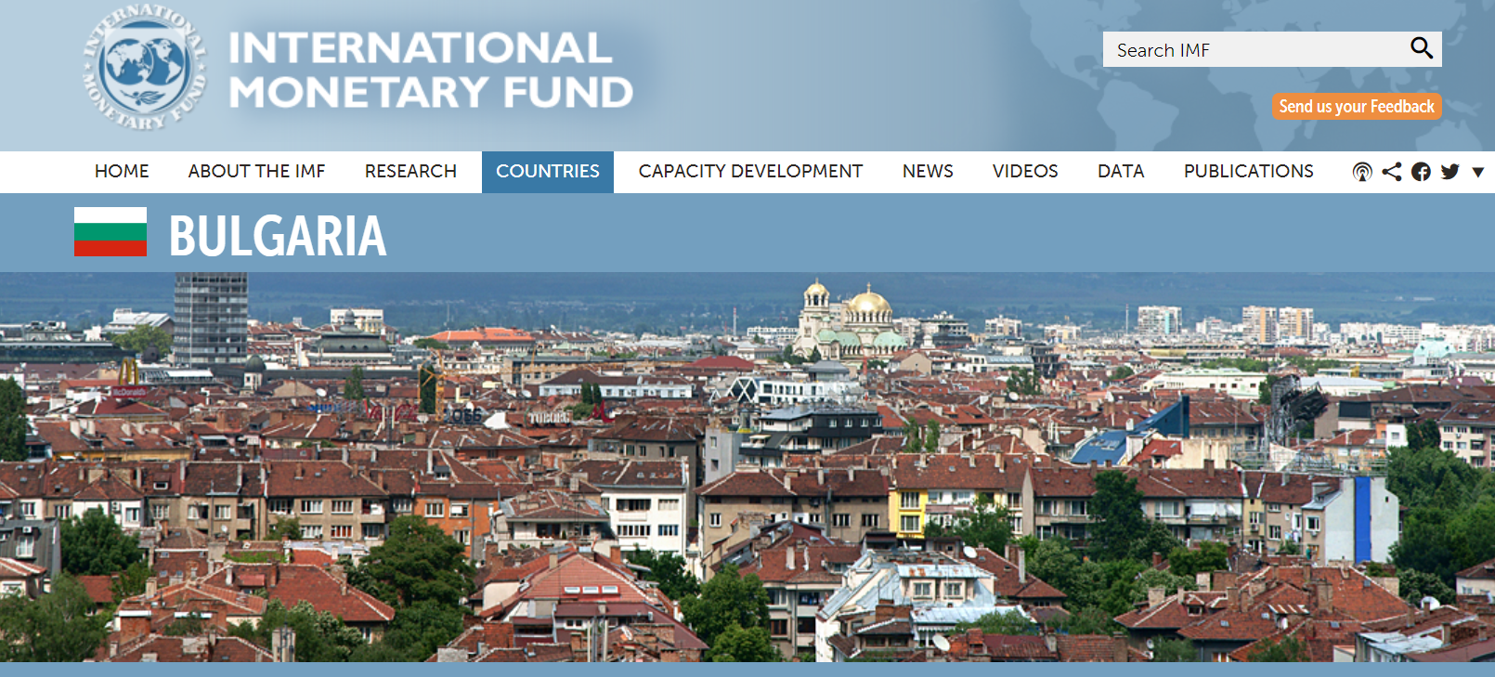
VII. The IMF in Bulgaria

Slide 25
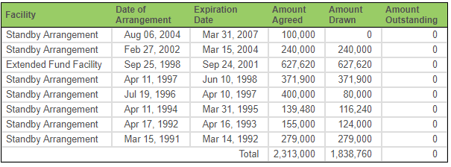
VII. The IMF in Bulgaria
Lending: Since Bulgaria became an IMF member in September 1990, it entered into several IMF-supported programs. The last program was precautionary
Bulgaria: IMF-supported programs (SDR thousand)

Slide 26
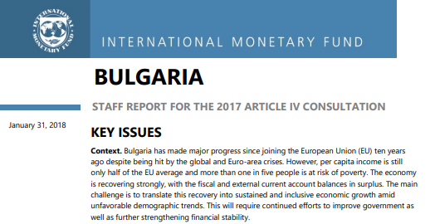
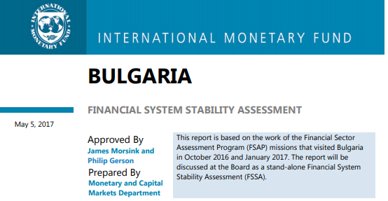
VII. The IMF in Bulgaria
Surveillance:
- Article IV: the Executive Board concluded the 2017 Article IV
Consultation with Bulgaria in February 2018
- FSAP: the Executive Board discussed the Financial System Stability
Assessment of Bulgaria in May 2017

Slide 27
VI. The IMF in a changing world
Public perception: the IMF may not always be popular, especially in program countries (conditionality), it is nevertheless needed. People often confuse the firefighter with the fire
Catalytic role: countries and/or other international/regional institutions willing to help a country with a Balance of Payments need often require that there is an IMF-supported program in place first. An IMF-supported program also helps regaining market access at affordable terms
Change: however, as the world changes, the IMF must adapt too
  Governance changes
  Operational changes
  Communication changes

Slide 28
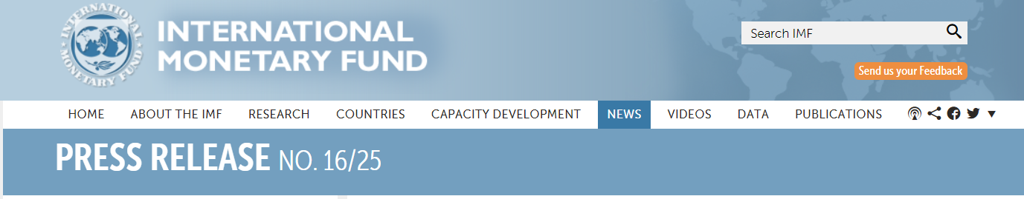
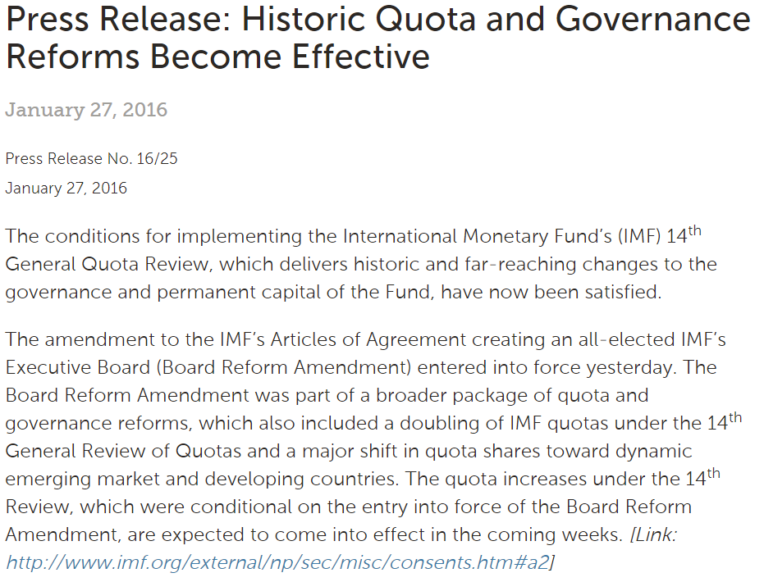
VI. The IMF in a changing world - governance
Governance changes:
The 2010 Quota and Governance Reforms were an important step forward
The 2010 Quota and Governance Reforms only came into effect in February 2016 after the US ratified the proposals (85% majority required)
The reforms resulted in a shift of more than 6% of quota shares to dynamic emerging market and developing countries, while protecting the quota shares and voting power of the poorest members

Slide 29

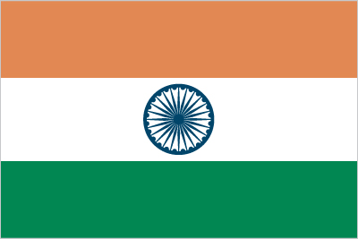
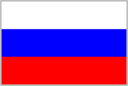
VI. The IMF in a changing world - governance
Before the 2010 reforms | After the 2010 reforms
US (16.75%) | US (16.53%)
2. Japan (6.23%) | 2. Japan (6.16%)
3. Germany (5.81%) | 3. China (6.09%)
4. UK (4.29%) | 4. Germany (5.32%)
5. France (4.29%) | 5. UK (4.04%)
6. China (3.81%) | 6. France (4.04%)
7. Italy (3.16%) | 7. Italy (3.02%)
8. Saudi Arabia (2.80%) | 8. India (2.64%)
9. Canada (2.56%) | 9. Russia (2.59%)
10. Russia (2.39%) | 10. Brazil (2.22%)

Slide 30
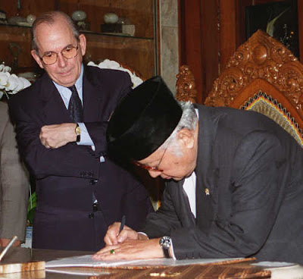
VI. The IMF in a changing world - tasks
Operational changes: the IMF learned lessons from previous programs and crises:
Better country ownership: it is crucial that the authorities own an IMF-supported program, share and support its contents and goals
More transparency and accountability: most Board documents are made public, and the IMF has increased its outreach towards CSOs, academics, private market participants, labor unions…
More tailored policy advise: programs cannot be one-size-fits-all, but need to be country-specific
Broader scope: programs now take into account macro-social issues, gender issues (e.g. labor market participation), the effects of inequality…

Slide 31
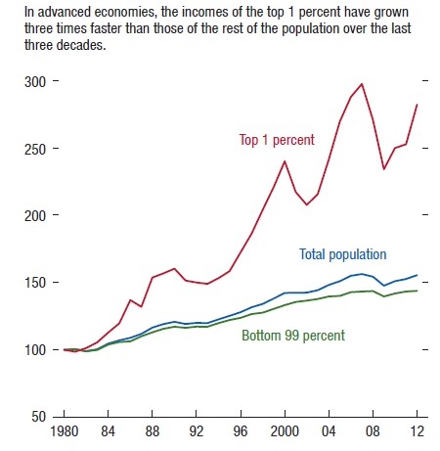
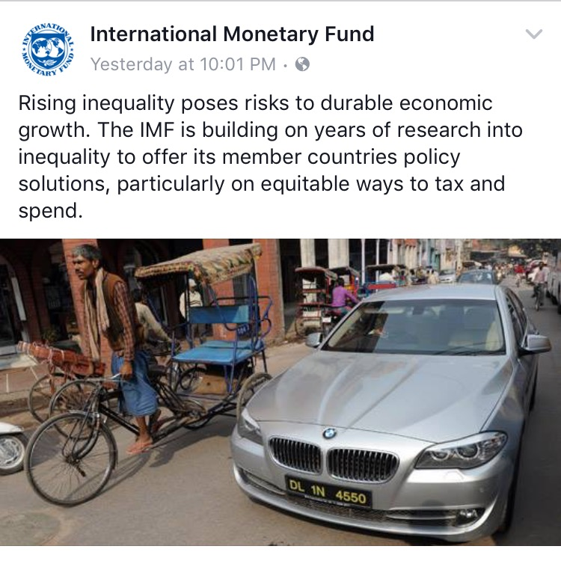
VI. The IMF in a changing world - tasks
The Managing Director’s April 2017 Global Policy Agenda: A More Inclusive and Resilient Global Economy

Slide 32
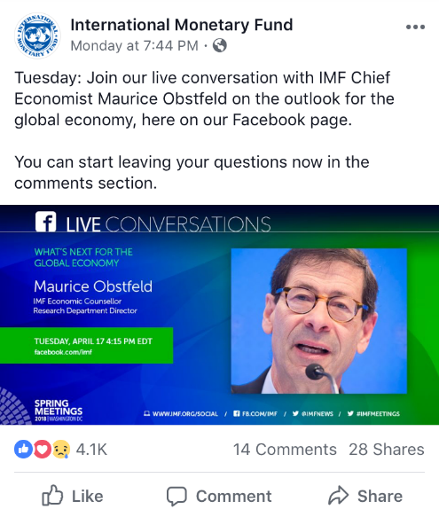
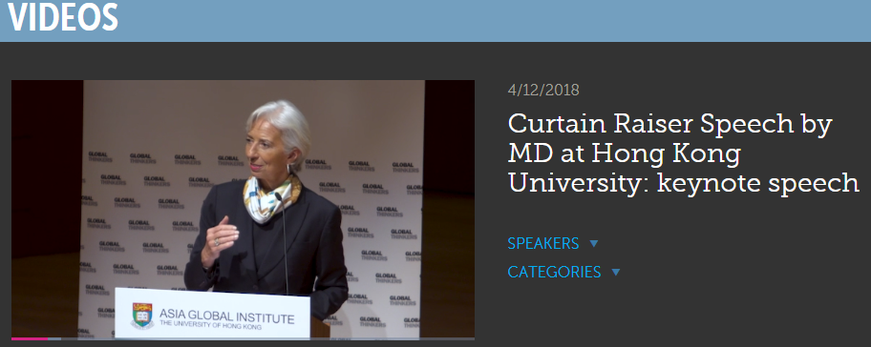
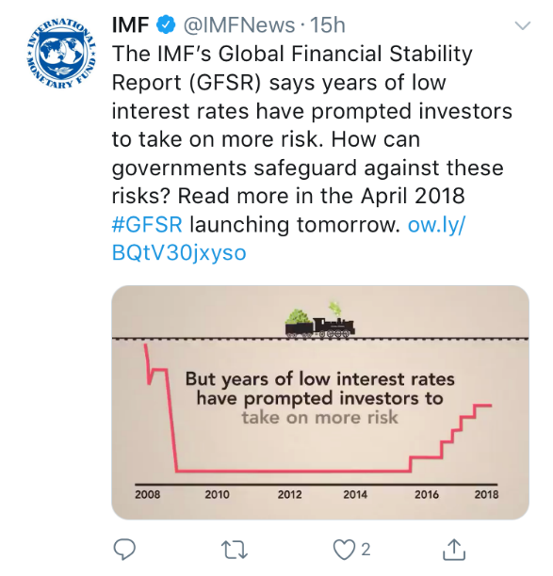
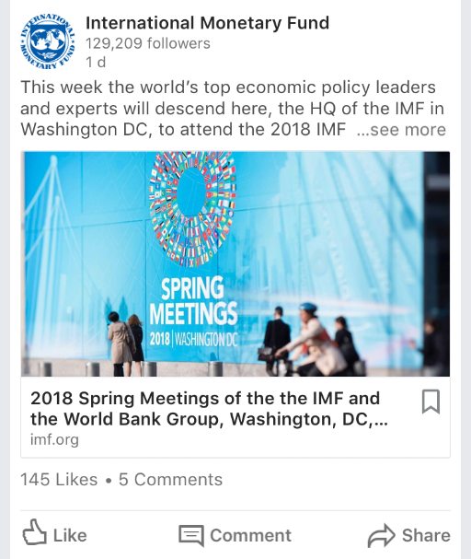

VI. The IMF in a changing world - communication
Communication changes: the IMF broadened its audience and started using tools for a TLDR world

Slide 33
VII. Challenges for the future
Going forward the IMF has identified a number of important challenges for the world economy
Climate change:
Temperature increases will trigger large falls in GDP per capita across many countries around the world
Natural disasters have a negative impact on fiscal balances/debt ratios (e.g. high costs related to hurricanes in the Caribbean)
“The Fund has a role to play in helping its members address those challenges of climate change for which fiscal and macroeconomic policies are an important component of the appropriate policy response” Managing Director Christine Lagarde

Slide 34
VII. Challenges for the future
Market dominance of high-tech companies:
Size: revenues of large corporations are comparable in size to some countries’ GDP
Dominance: companies like Amazon, Facebook, Google, Netflix acquire rivals before these companies can reach a critical mass (winner takes all model)
Competition: should an online platform with monopoly power be regulated, comparable to other network sectors like e.g. electricity? Which (inter)national competition authority will enforce the rules?
Property rights: should data property rights be redefined to provide individuals more control over their data?

Slide 35
VII. Challenges for the future
The economic impact of new technologies:
AI: will lead to a massive expansion in data access and use (currently +/-80% of the world’s data is not searchable). There are important applications in economics: e.g. transparency/trust in financial services, AML procedures, regulation and compliance…
Blockchain: transaction costs will decrease substantially, e.g. in the transportation sector, in real estate transactions…
Labor market: will new technologies lead to massive job losses or shifts in jobs to other sectors? What are the implications for education models and for low-skilled workers?
Government revenues/tax systems: How to define physical presence, source, and destination? Should automation and digitization be taxed (versus labor)? Should peer-to-peer transactions be taxed, and if so, how?

Slide 36
VII. Challenges for the future
Cyber security and the systemic impact of cyber incidents:
Scenarios: there are various possible scenarios of cyber incidents with a systemic impact (critical services disruption, data integrity issue, confidentiality breach…)
Cooperation: national cyber security preparedness varies across countries; cyber defense efforts are too decentralized and international/regional cooperation is lacking
Public good: the potential systemic impact of a cyber incident, e.g. in the financial sector, is too large for cyber security to be left to private sector weaknesses
Standards: should minimal cyber security standards be developed in critical sectors? Which authority will enforce them?

Slide 37

Благодаря
Anthony De Lannoy, Executive Director
adelannoy@imf.org
@A_De_Lannoy

