Slide 1
YOUR COMPANY NAME AND LOGO
PITCH DECK
template
Notes:
Logo + One liner (Exciting one sentence company description).
General Guidelines
General notes on creating pitch decks:
Avoid using ready-made powerpoint templates (or at least the Microsoft ones)
Try using the company’s general colous (see website, logo, mobile app etc.)
Use a solid color background or a gradient background for content slides.
You can get flat icons in any color from https://www.flaticon.com/
Try finding a good balance between text and content. A pitch deck that is pitched live requires less text and more visuals and vice versa: a pitch deck that is to be only sent out requires more content
Try to have icons/text bundles aligned horizontally and vertically
Make sure that one Font is used throughout the pitch deck
Avoid using fonts smaller than 12
If there are any charts, graphs etc. – try to have them in the overall colors of the presentation
Try not to exceed 20 slides

Slide 2
Mission statement
Notes:
Basically the company’s mission statement / more elaborate description.
Depending on how long you need your presentation be, you can keep this slide optional

Slide 3



THE PROBLEM
Problem 1
Problem 2
Problem 3
Notes:
Outlining the main problems that the company aims to solve. Problems equal market gaps and customer pain points.

Slide 4



THE SOLUTION
Feature or product 1
Feature or product 2
Feature or product 3
Notes:
What is the solution to the problems?

Slide 5
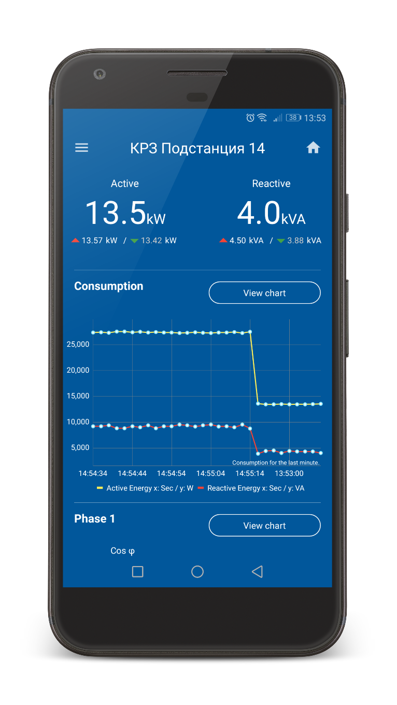
PRODUCT
FEATURE 1
explanation text…….
FEATURE 2
Text……..
Notes:
This slide and the next are the PRODUCT SLIDES. It can be one, two or more slides that show the actual product – explain the features and preferably show a product demo / screenshot /

Slide 6
WHY NOW?
INTERNET OF THINGS
INDUSTRY 4.0
Industry 4.0 is in full swing and manufacturers are desperate to cut costs through technology and connectivity
Notes:
Why now is the best time for this. In this slide a graphic about the emerging market trend and main technology (example IoT) makes sense.
Optional slide!

Slide 7
THE MARKET
$23 bln.
Global market
TAM
$72.7 bln.
More specific market
SAM
59%
SOM
Notes:
What is the global market size? How much is it growing? What is the addressable market size (global energy management systems in this case).
It’s really important to show both the Target Addressable Market (TAM) measured from the top down and the Serviceable Addressable Market (SAM) which is the part of TAM that you can realistically achieve.

Slide 8
BUSINESS MODEL
€700
Price per user
€50/month
Subscription for
web & mobile app
One-time
Recurring
Notes:
Outline the main revenue streams for the company?
Pricing model – can be left out if already mentioned somewhere else.

Slide 9
BUSINESS MODEL
Text…………
Notes:
Optional slide clarifying the business model.

Slide 10

CUSTOMER SEGMENTS
Notes:
A must have slide on customers: Who are the target customers? How many are they locally and internationally? (Estimates if hard data is not available)
Pick appropriate icons and minimal text to explain the segments
This is an optional slide

Slide 11
COMPETITION
ADVANTAGES
LOCAL MARKET
………..
ADVANTAGE 1
………….
ADVANTAGE 2
………….
ADVANTAGE 3
………….
EUROPEAN MARKET
…………
Notes:
A slide outlining main competition and competitive advantages. This slide can also take the format of a table outlining competition and competitive advantages.
Who is currently doing this and how are you better than them? A table or another graphic showing your competitive advantages in comparison to the competition is always a good idea here.

Slide 12
TRACTION
MVP
Functional
prototype
PILOT
XXXXX+
Number of users/devices/installs, etc.
Notes:
What are the most meaningful achievements so far in terms of product, users/customers, revenues, etc. Metrics vary due to company stage.
Make sure that the story is compelling enough but NEVER, ever use incorrect or vanity metrics.
Find out which metrics are the most relevant KPIs for your business. Showing an understanding of the Pirate (AARRR) metrics, as well as LTV, Churn and Growth MoM will increase your credibility.

Slide 13
PIPELINE
Company | Pick a Metric | Status
Client 1 | 38 | Paying
Client 2 | 28 | In talks
Client 3 | 20 | In talks
Client 4 | 400+ | In talks
Notes:
A table outlining pipeline of existing and potential customers.

Slide 14
PRODUCT ROADMAP
MVP
MARKET-READY
PRODUCT
REMOTE CONTROL
+ USAGE OPTIMIZATION
MARKETPLACE
H1
2017
H2
2017
H1
2018
H2
2018
H1
2019
PILOT
+ FEEDBACK
IN-APP
PAYMENTS
B2C
PRODUCT
Notes:
Development roadmap of the product. What features are live and what will be added next.
This is an example of a Product Roadmap, feel free to change/design it as creatively as possible

Slide 15
FORECAST
Profit & Loss
Revenue Breakdown
Notes:
The two most important graphs based on the financial model.
This is an example

Slide 16
FUNDING ROUND
€ 300 000
Seed Investment
€ 1.5 mln.
Valuation
€ 130K
Committed
Notes:
How much is the company raising? What is the valuation? Is there any funding secured so far?
This is an example!

Slide 17
INVESTMENT BREAKDOWN
Notes:
How is the funding going to be allocated?
This is an example

Slide 18

TEAM
Name
CEO
Experience
Name
CTO
Experience
Notes:
A slide showing the founding team and most important career experience.

Slide 19
PARTNERS
Notes:
Are there any partnerships secured? How are they helping the company?
Put some logos here

Slide 20
Contacts and Thank you!
aaa@xyz.com
Notes:
Contacts of your company and thank you slide
Your logo or company name should be here too

